Slide 1

Dalas Presentation : Why do some football teams dominate their leagues?
Antoine Théologien, Armand Bonn
M1 DAC
2024-2025

Slide 2
Introduction and motivations
Some teams are winning more than others : Why ?
Key factors of a football club success
Data Analysis and predictions

Slide 3
OUR DATA
Top 5 championships
Matches Results and events
Clubs data : Players value, age…
Focus on 3 seasons : from 2021 to 2024

Slide 4
First feature : Market value
Obvious but true : money creates victory
For every championship, richest clubs finish higher
But not a guarantee !

Slide 5
Investment in defense : not a great solution
If defense value higher than attack value : less goal scored
Prioritize investments in attackers or midfielders
Which kind of players should be bought ?

Slide 6
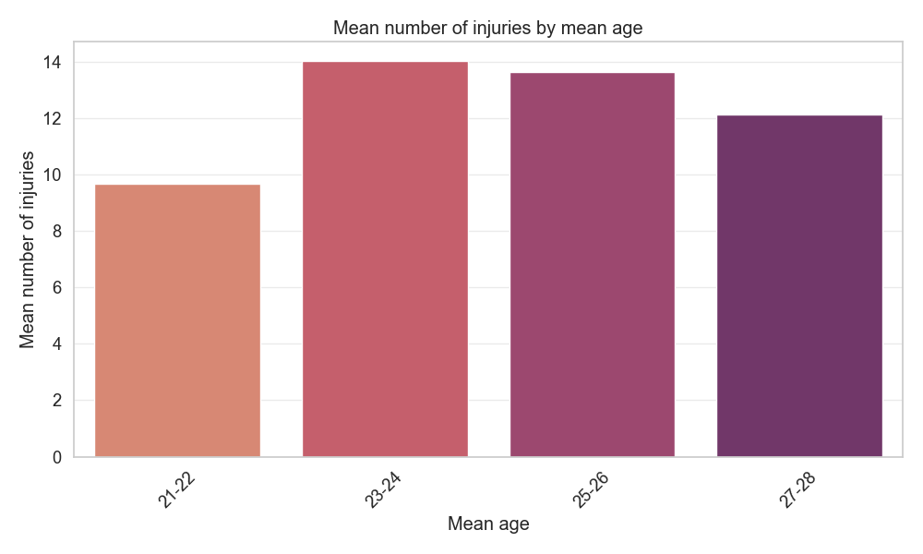
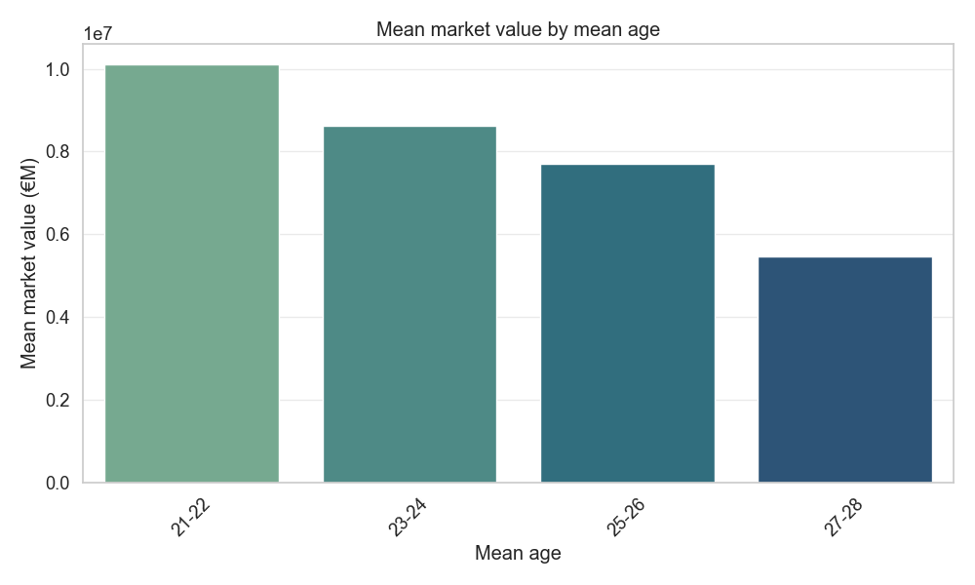
Focusing on young players : not that useful
They also cost much more than the older ones
Young players are not particularly prone to injuries

Slide 7
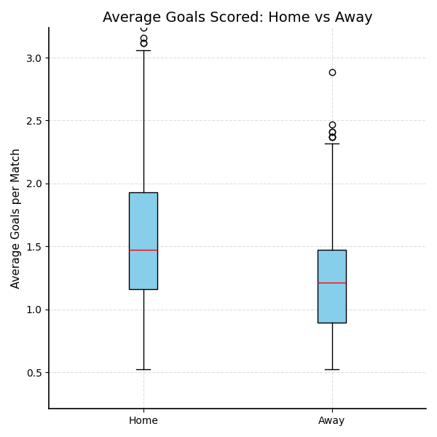
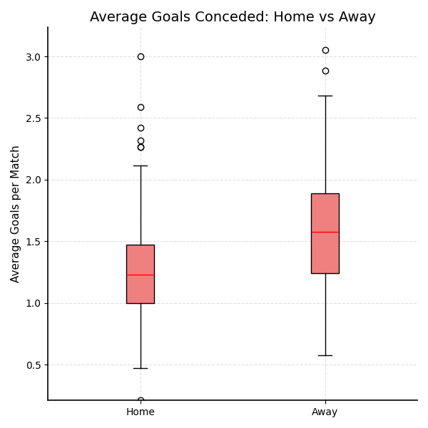
IS IT BETTER TO PLAY AT HOME ?
Fast answer : YES !
Home teams score more and conced less
Best teams win more on away match

Slide 8
One of the most important feature : Team form

Slide 9
Same tendancy in each league

Slide 10
OUR PREDICTIONS
Accuracy of winning prediction : 72 %
Data explained by our features : team form, market values on each position
Most important variable : Clean sheet potential

Slide 11

Conclusion
Main features explaining a win : Market Value, Team form and Clean Sheet Potential
To improve your results : invest on attacking players, less in defence
There is a great part of uncertainty : that’s what makes it beautiful !

